Slide 1


Slide 2
Hardware Design

Slide 3

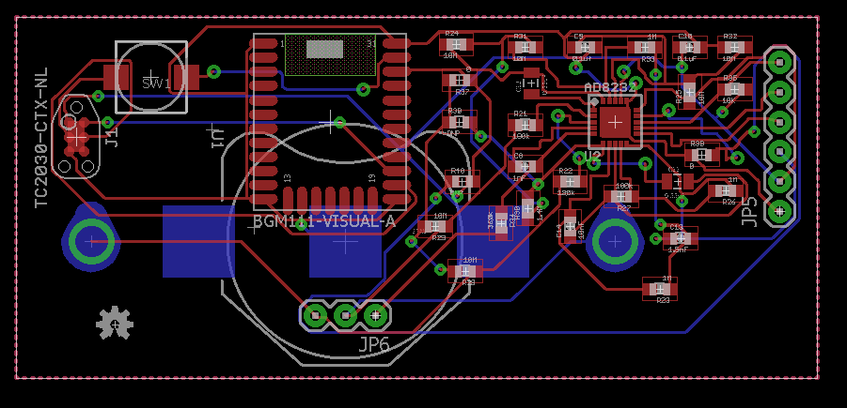
ECG BOARD

Slide 4
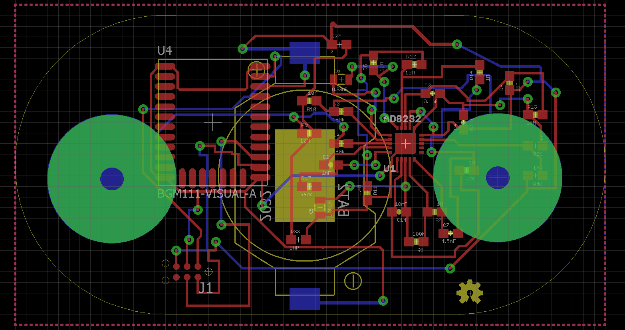
ECG BOARD

Slide 5
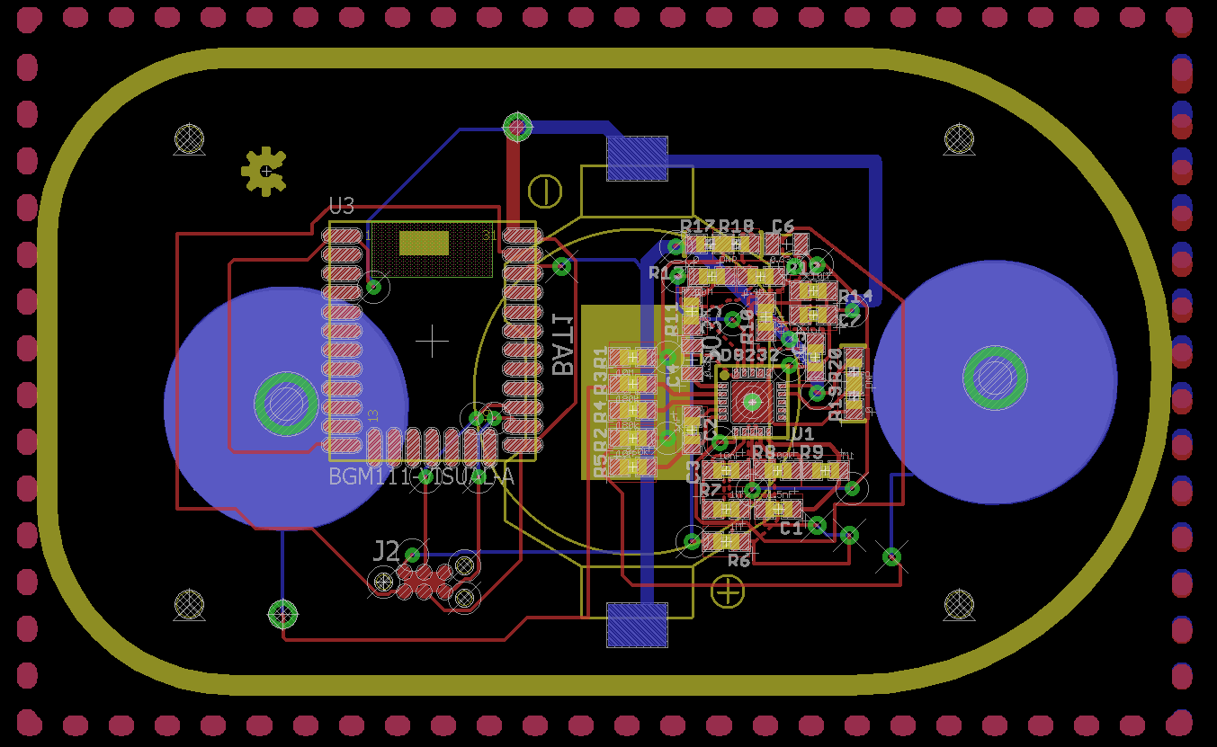
ECG BOARD

Slide 6
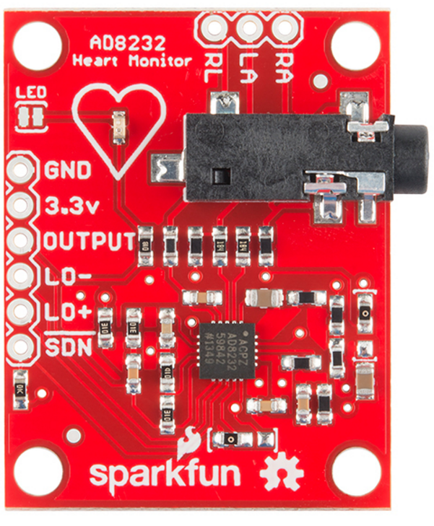
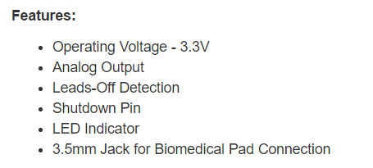
ECG HEART RATE MONITOR
Spark Fun AD8232

Slide 7
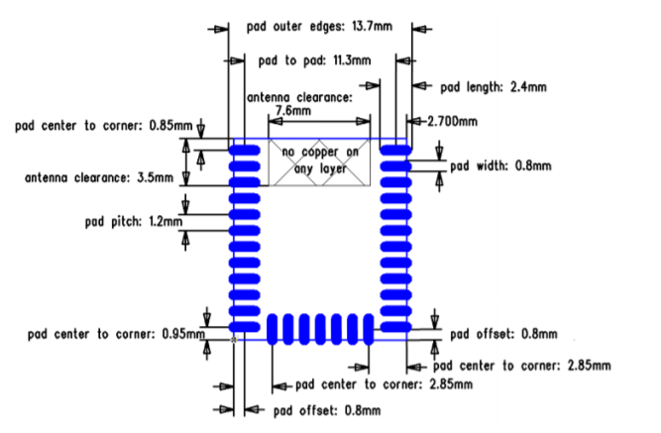
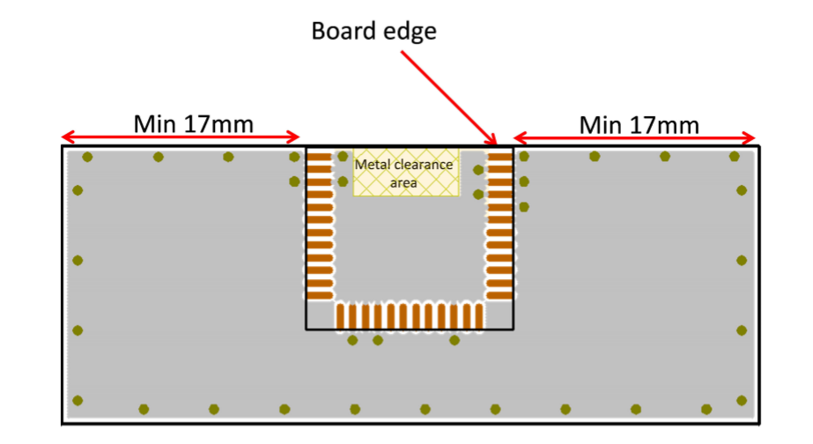
BGM111 : Metal Clearance
BGM111 Module

Slide 8
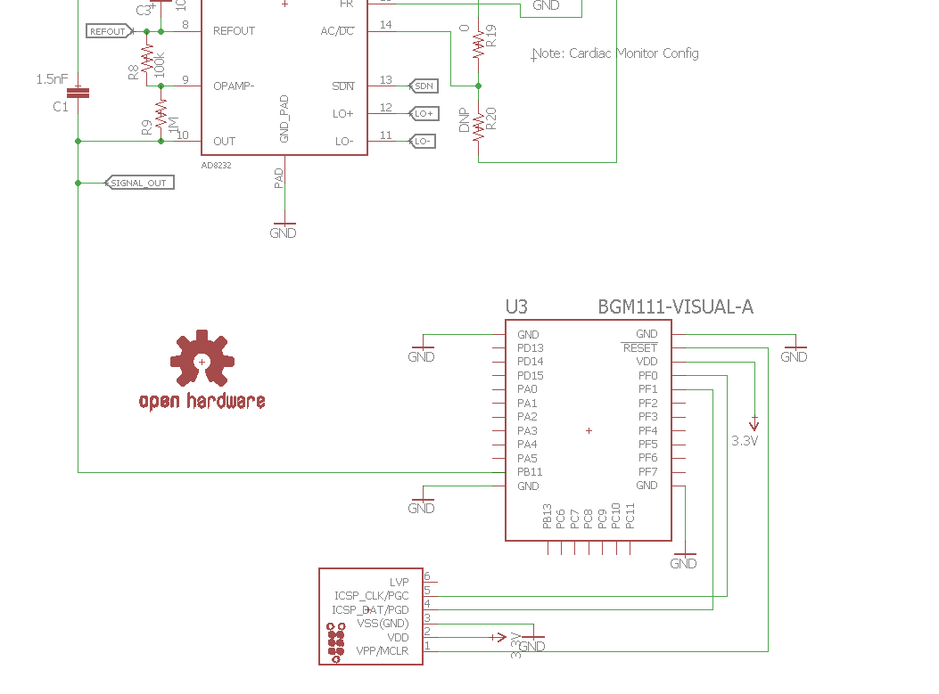
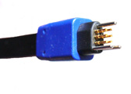
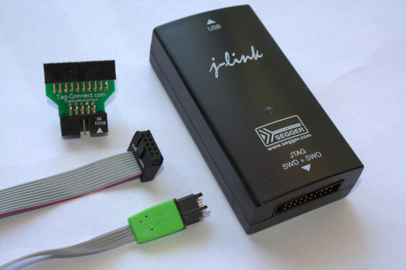
TAG CONNECT FOR DEBUGGING
TAG CONNECT

Slide 9
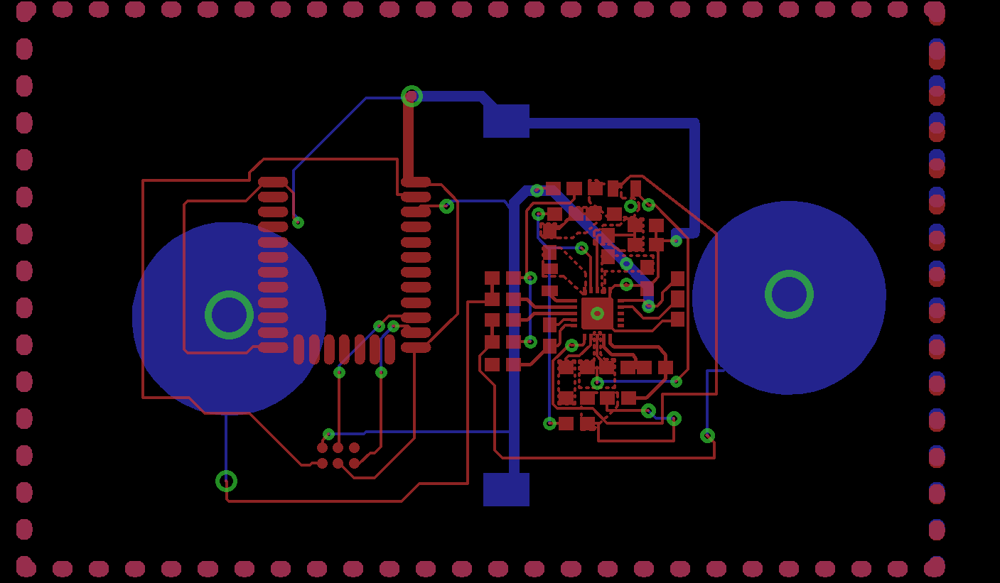
ECG BOARD LAYERS

Slide 10
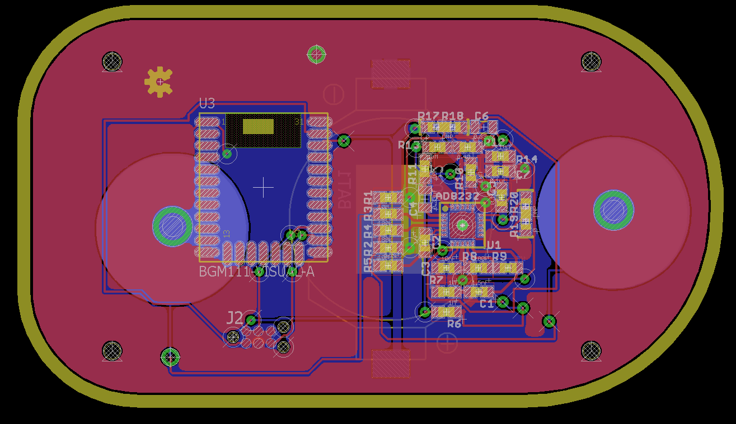
ECG BOARD WITH GROUND PLANES

Slide 11
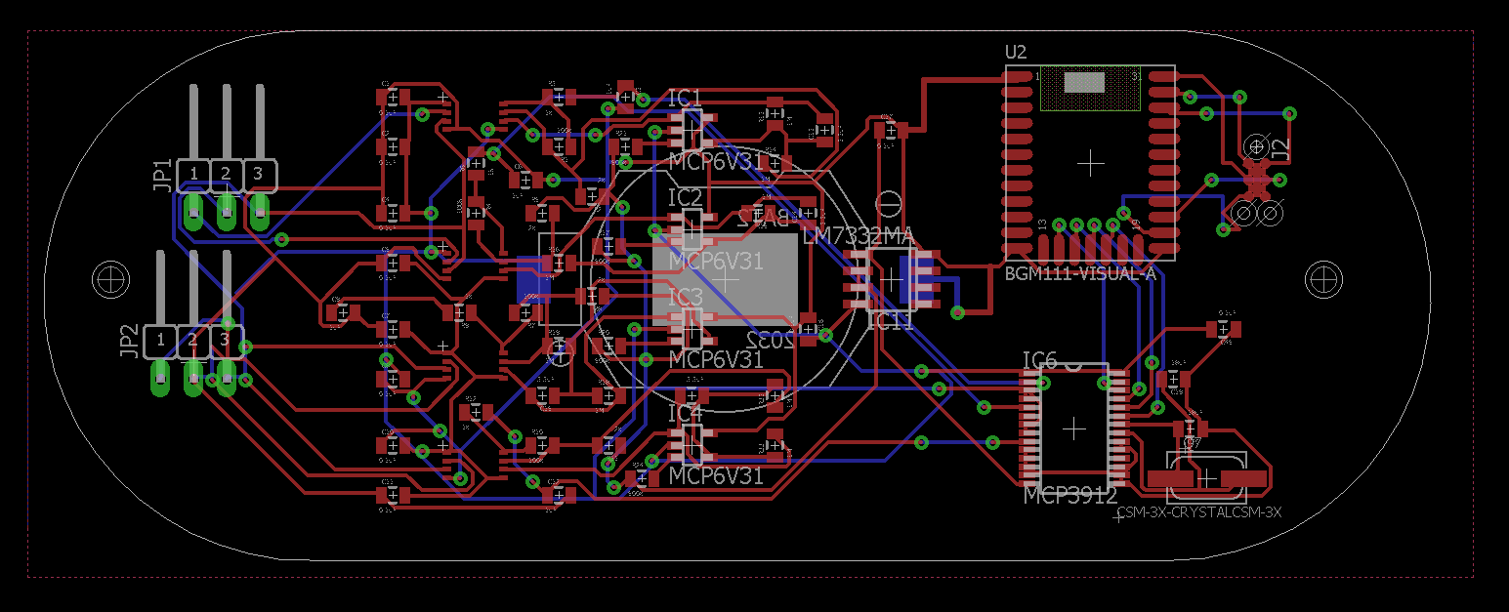
EEG/EMG BOARD

Slide 12
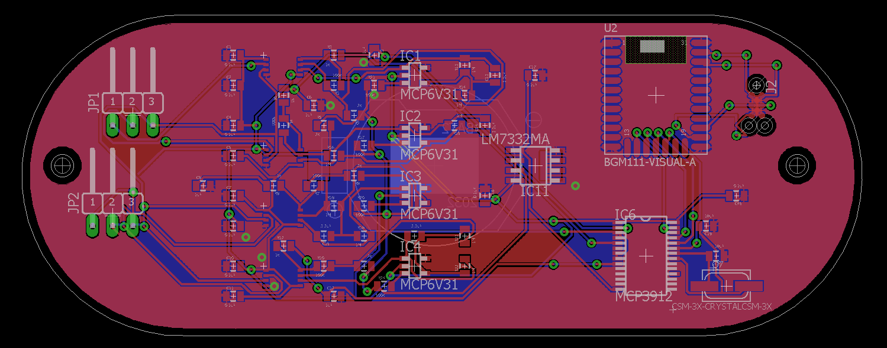
EEG/EMG BOARD WITH GROUND PLANES

Slide 13
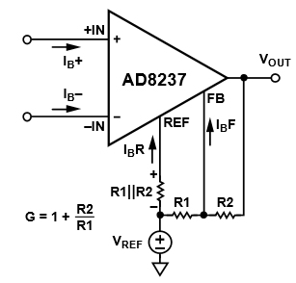
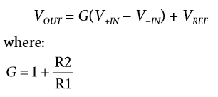
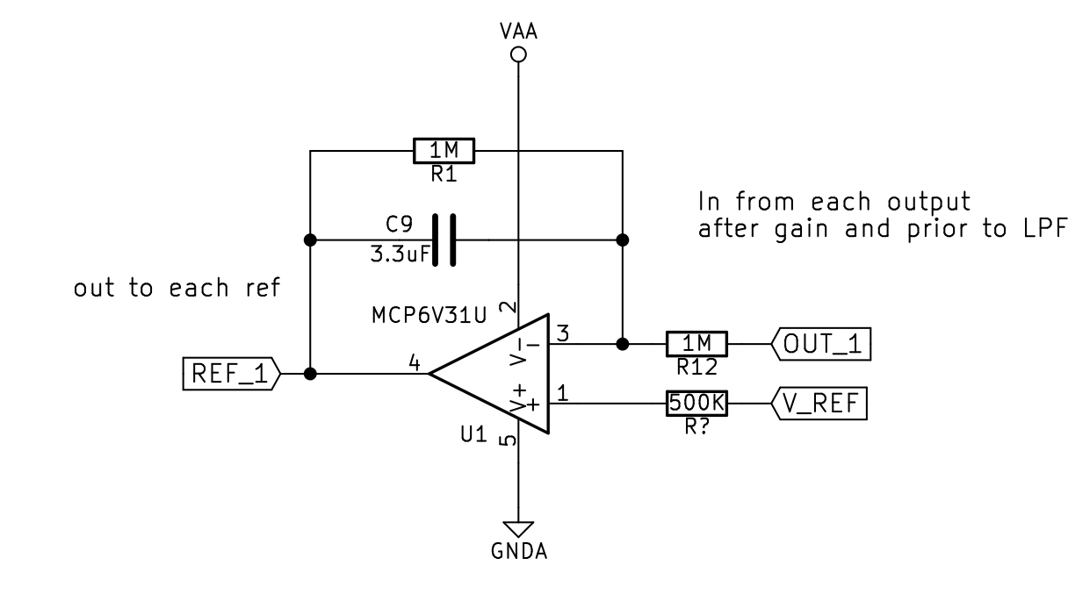
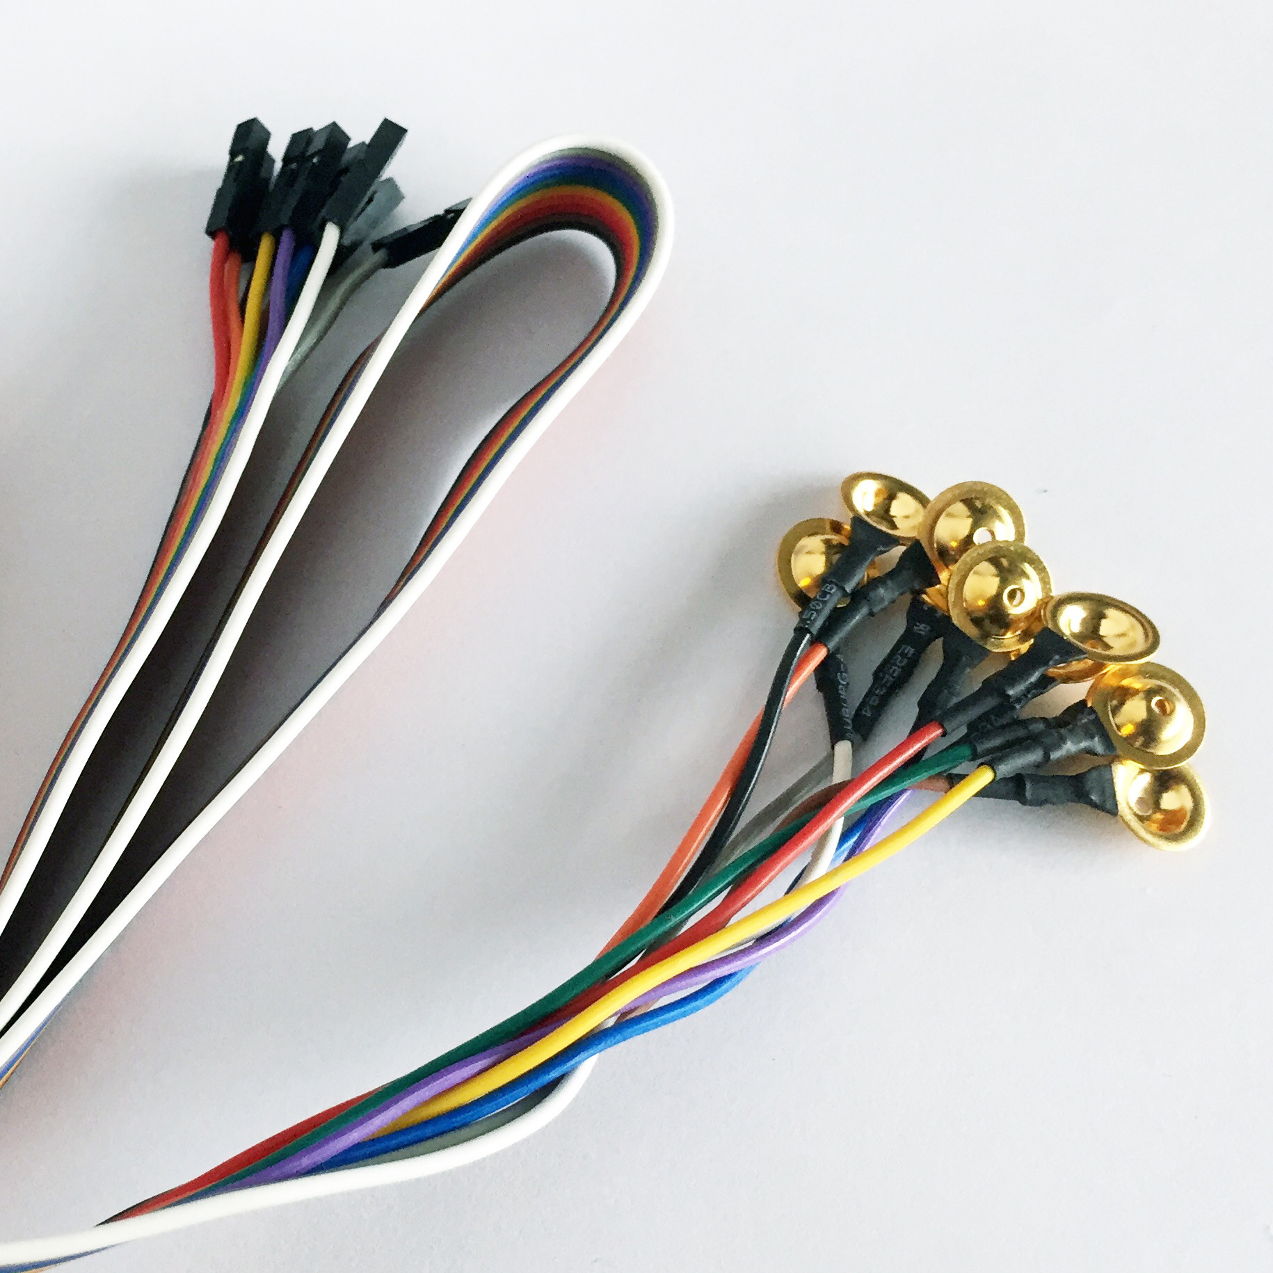
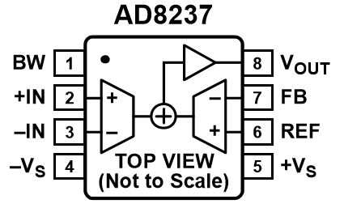
EEG/EMG BOARD
Setting the GAIN

Slide 14
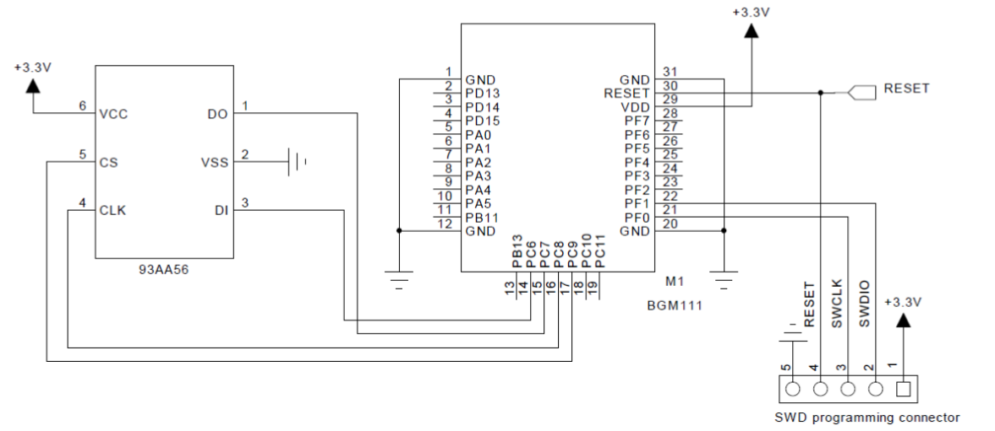
EEG/EMG BOARD
BGM111 Module
3V Four-Channel Analog Front End

Slide 15
Bill of Materials for ECG, EEG/EMG Boards
ECG
Device | Value/Model # | Package | Quantity
Chip | AD8232 | LFCSP_20 | 1
Chip | BGM111-VISUAL-A | BGM111-A | 1
Chip | TC2030-MCP-NL | TC2030-MCP-NL | 1
Resistor | 0, DNP, 100K, 180K,360K, 1M, 1,4M, 10M | 0603 | 18
Capacitor | 1n, 0.1u, 1.5n, 10n | 0603 | 5
Capacitor | 0.33u | 0805 | 2
Snap Buttons | d=0.6” |  | 2
EEG/EMG
Device | Value/Model # | Package | Quantity
Chip | AD8237 | MSOP8 | 4
Chip | BGM111-VISUAL-A | BGM111-A | 1
Chip | CSM-3X-CRYSTALCSM-3X | CSM-3X | 1
Chip | LM7332MA | SO08 | 1
Chip | MCP6V31 | SOT23-5 | 4
Chip | MCP3912 | SSOP28 | 1
Chip | TC2030-MCP-NL | TC2030-MCP-NL | 1
Resistor | 1K to 1M | 0805 | 24
Capacitor | 0.1u to 18u | 0805 | 21
JUMPER | 3pins |  | 2

Slide 16
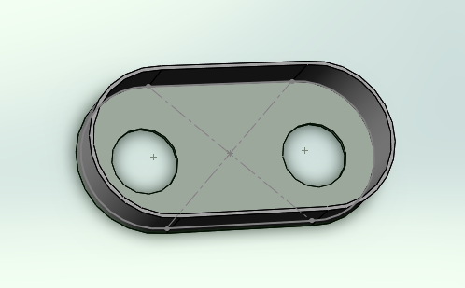
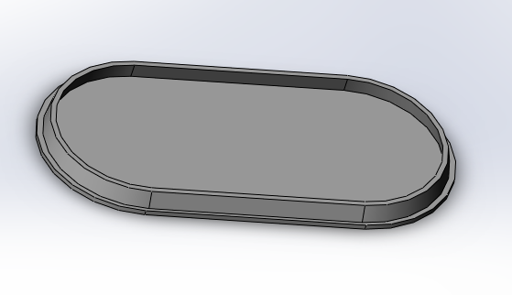
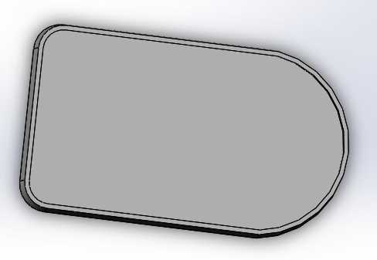
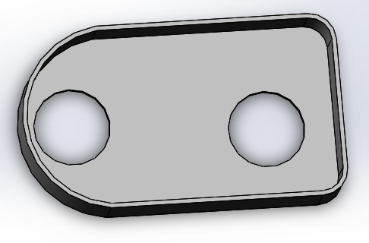
Case Designs for ECG Board
Design 1
Design 2

Slide 17
Thank You !

